Slide 1

Statistics with Spa ows
Lecture 10
Julia Schroeder
Julia.schroeder@imperial.ac.uk

Slide 2
Aims
Understanding covariance
R²
Understanding correlations
Sums of squares

Slide 3
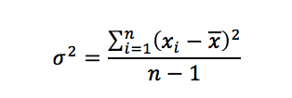
Variance
x
Variance:
The sum of the squared deviations from the mean (divided by n-1)
x_{i}

Slide 4
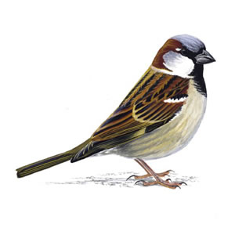
Covariance
How two variables change together
Population: joint probability distribution

Slide 5
Covariance
How two variables change together
Population: joint probability distribution
Sample: covariance estimate

Slide 6
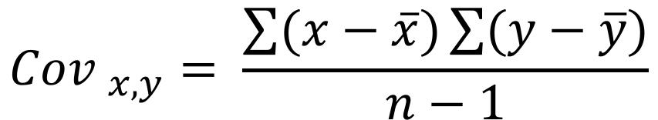
Covariance
$${Cov }_{x,y}= \frac{\sum{(x−\overline{x}})\sum{(y−\overline{y}})}{n−1}$$

Slide 7
https://i.imgur.com/cWwxYa9.gifv

Slide 8
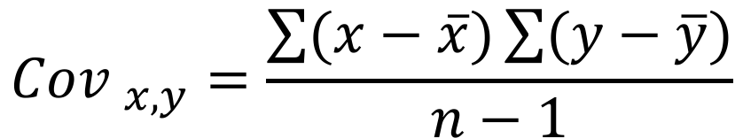
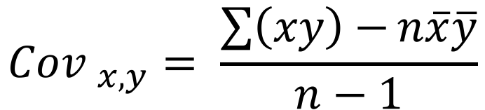
Covariance
$${Cov }_{x,y}=\frac{\sum{(x−\overline{x}})\sum{(y−\overline{y}})}{n−1}$$
$${Cov }_{x,y}= \frac{\sum{\left(xy\right)−}n\overline{x}\overline{y}}{n−1}$$

Slide 9
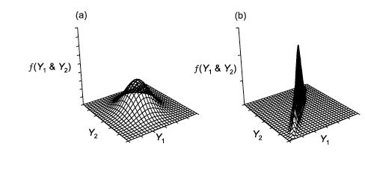
Covariance
$${Cov }_{x,y}= \frac{\sum{(x−\overline{x}})\sum{(y−\overline{y}})}{n−1}$$

Slide 10
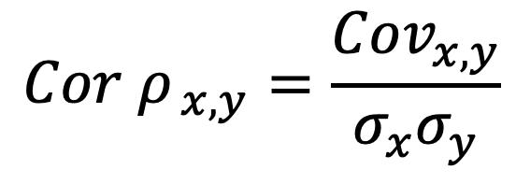
Covariance vs Correlation
$${Cov }_{x,y}= \frac{\sum{(x−\overline{x}})\sum{(y−\overline{y}})}{n−1}$$
$${Cor ρ}_{ x,y}=\frac{{Cov}_{x,y}}{σ_{x}σ_{y}}$$

Slide 11

Covariance vs Correlation
Ok, why do we need two versions of this?
$${Cov }_{x,y}= \frac{\sum{(x−\overline{x}})\sum{(y−\overline{y}})}{n−1}$$
The correlation coefficient is the covariance divided by the product of the standard deviations
It is the standardized version of the covariance
$${Cor ρ}_{ x,y}= \frac{{Cov}_{x,y}}{σ_{x}σ_{y}}$$

Slide 12
Covariance vs Correlation
Ok, why do we need two versions of this?
$${Cov }_{x,y}= \frac{\sum{(x−\overline{x}})\sum{(y−\overline{y}})}{n−1}$$
The correlation coefficient is the covariance divided by the product of the standard deviations
It is the standardized version of the covariance
r_{x,y} =Pearson’s correlation coefficient
$${Cor ρ}_{ x,y}= \frac{{Cov}_{x,y}}{σ_{x}σ_{y}}$$

Slide 13
Correlation coefficient r Coefficient of determination R²
Describes the relationship between x an y
Between -1 and 1
Describes how strong x and y are correlated
Between 0 and 1

Slide 14
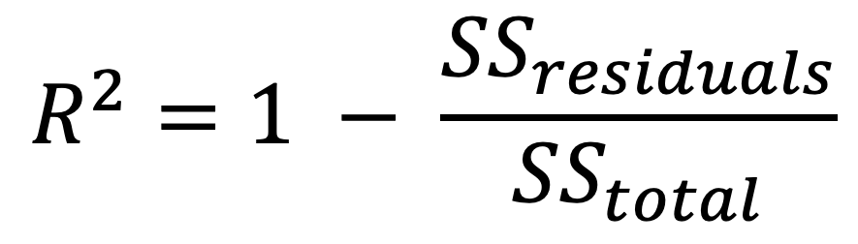
R²
Coefficient of determination
Proportion of how much variance in y is explained by x
One explanatory variable: r²
Or: How much variance remains unexplained
$$R^{2}=1 − \frac{{SS}_{residuals}}{{SS}_{total}}$$

Slide 15
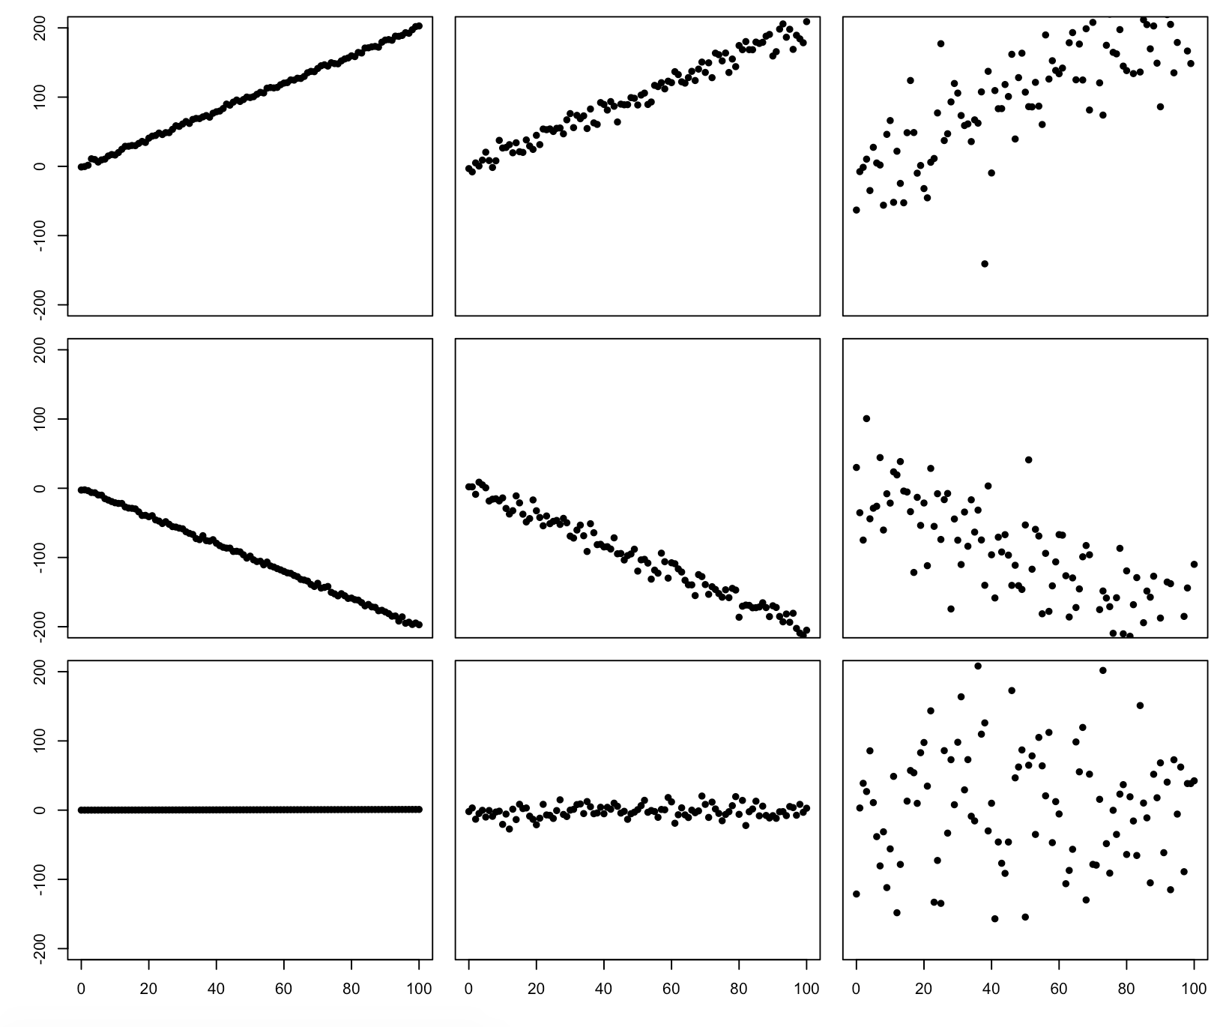
Cor = 0.99
R² = 0.99
Cov = 1725
Cor = 0.98
R² = 0.97
Cov = 1730
Cor = 0.80
R² = 0.65
Cov = 2110
Cor = - 0.99
R² = 0.99
Cov = - 1710
Cor = - 0.98
R² = 0.97
Cov = - 1755
Cor = - 0.79
R² = 0.62
Cov = - 1899
Cor = 0.99
R² = 0.99
Cov = 8.6
Cor = 0.15
R² = 0.023
Cov = 41
Cor = -0.03
R² = 0.01
Cov = - 84

Slide 16
Take home:
Differences between correlation coefficient, R², slope, and covariance

